Slide 1
URL SHORTNER FOR Purplle.com
BY ROHIT JANGID
B.TECH 3RD YEAR
ELECTRICAL ENGINEERING
IIT ROORKEE

Slide 2
BASIC IDEA
The original url will be called as Url.
The short version of URL will be called ShortUrl.
When user open the link to application, application will check if any ShortUrl is passed to application or not.
If ShortUrl is passed to application, the Url corresponding to given ShortUrl is searched in database and if found, user is redirected to that Url.
If ShortUrl is not passed, a homepage is opened where the user can create ShortUrl’s for their own Url’s.

Slide 3
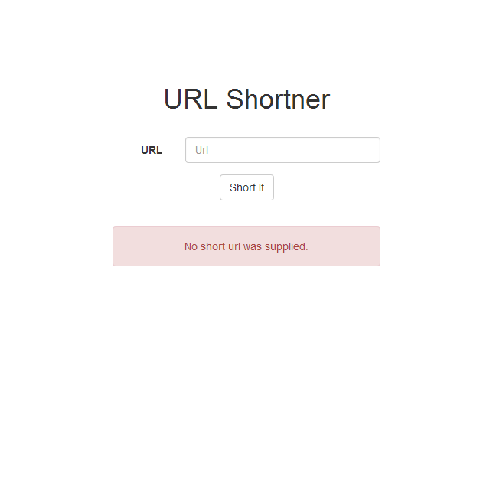
BASIC INTERFACE

Slide 4
WORKFLOW FOR SHORTNING OF URL’S
After user entered the Url and hit ‘Short it’ button, Url is Examined.
After confirming that the Url is valid and does exist, it is passed for further process.
A quick check is done to see if the Url already exist in database or not. If it do, an error is shown below.
A ShortUrl is created for the Url.
Timestamp is noted from server and Hits counter is also initialized.
All the information is then stored in the database.

Slide 5
CHARACTERSTICS OF SHORTURL’S
ShortUrl’s is generated from a collection of 50 characters which is already provided in the class.
The length of ShortUrl’s varies from 1 onwards.
The collection of characters is made up of numbers and alphabets including small and capital letters.
The vowels are removed to reduce the chance for forming unappropriate words for ShortUrl’s.
Few characters which are visually same are removed too for avoiding confusion.
Length of 1 character provide 50, 2 characters provide 2500, 3 characters provide 125000 and so on. So there can be a lot of ShortUrl’s which can be generated.

Slide 6
PROCESS OF CREATING SHORTURL
A unique id is provide to each Url which is used for creating ShortUrl
The id is used to as an index to choose character from the string set.
If id exceed the length of string, then the mod of id and length of string is calculated and that is used as index.
The id is divided by length of string and the floor value is considered.
Now current id is used as an index and is prefixed to the previous character.
This process continues until the id is less then length of string.

Slide 7
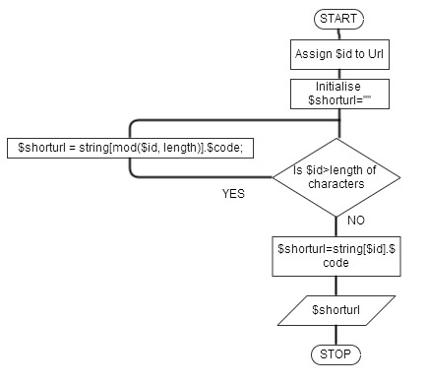
FLOWCHART FOR CREATING SHORTURL

Slide 8
WORKFLOW FOR URL REDIRECTION
If user provide the ShortUrl then the application redirect to the Url.
The ShortUrl is used to find the Url in database.
The Hits counter is increased by unity.
The webpage is then redirected to the Url.

Slide 9
OTHER POINTS
User provide the ShortUrl as for ex:- localhost/manash/Rohit where localhost/manash is the base url and Rohit is ShortUrl.
If the application is uploaded on server then localhost/manash is replaced by www.domainname.com and whole url will be www.domainname.com/Rohit.
.htaccess file is used for rewriting the url. This url is converted into localhost/manash/scripts/url_redirect.php?su=Rohit
url_redirect.php is a script which check the ShortUrl and redirect to valid Url.

Slide 10
FILE STRUCTURING
The include folder contain config.php and urlshortner.php which are configuration file and urlshortner class file respectively. These file has to be included in every script.
The scripts folder contain scripts like url_redirect.php and shorturl_request.php which are a url redirection script and backend for form present on main page.
All the views are present in views folder.
The dump of database is present in schema folder.
Only .htaccess file is present in root folder to manage redirects.

Slide 11
THANK YOU

